Slide 1
Basic Directive Structure
base directive
Config.json
html
cameraEditFormWidget
widgetManager
widgetManager
textInput
submitButton

Slide 2
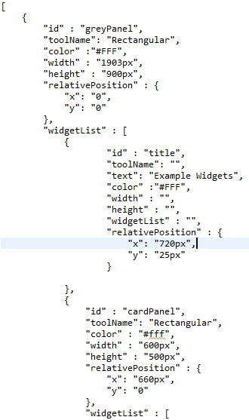
Config.JSon

Slide 3
HTML page

Slide 4
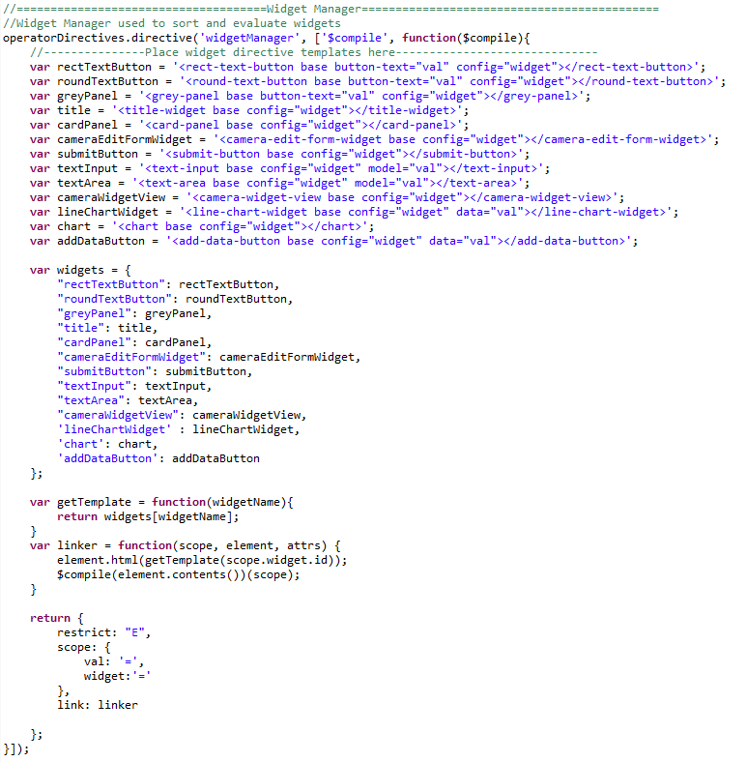
Manager

Slide 5
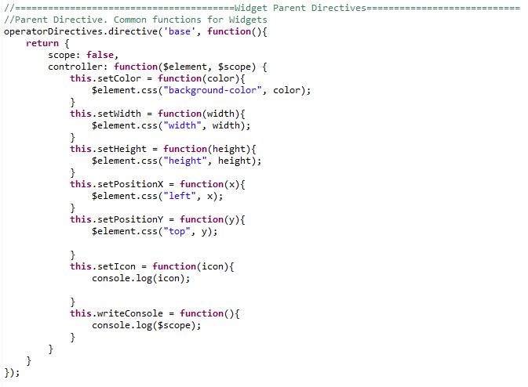
BASE

Slide 6
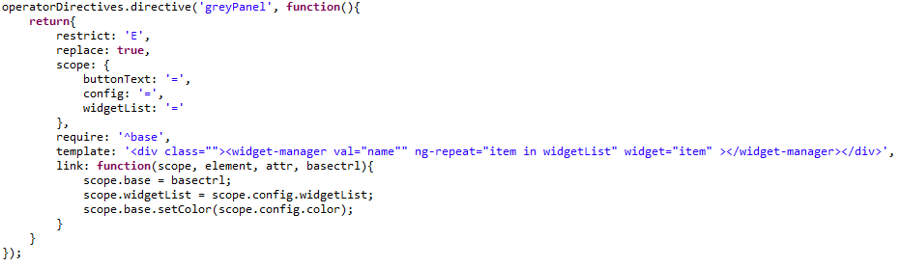
Directive

Slide 7
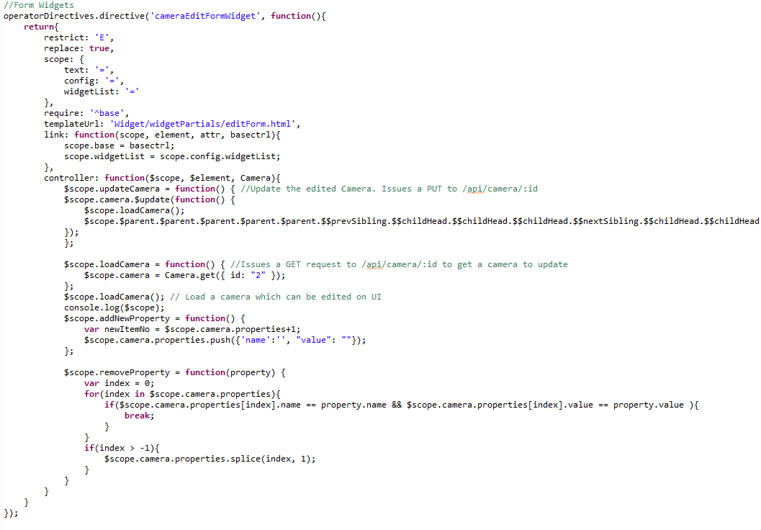
Creating Forms

Slide 8
Editform.html

Slide 9
Challenges
.css challenges:
Decide on positioning (absolute or relative)
Placing more .css information in config files
Sharing variables between directives:
Gets complicated, using services, factories, and scope sharing.
Directives are not meant to be widgets, just meant to modularize views and controllers:
Some “widgets” are smaller then necessary.

Slide 10
Better Methods
Make “Widgets” bigger in scope.
Add data that looks like .css to config files
Choose “larger” widgets (easier to share data, less complicated)
Data will need to be added to config file.

